Slide 1
ENTERTAINER ANALYSIS

Slide 2
Objective
Problem Statement
Normal life can be stressful, and people need to relax. Being entertained by others
is a wonderful way to take some time out of life. It can reduce stress and make life's
issues easier to face. The media and entertainment industry consists of film,
television, radio and print. These segments include movies, TV shows, radio shows,
news, music, newspapers, magazines, and books. Entertainment industry is a group of
sub-industries devoted to entertainment. Entertainment industry is used to describe the
mass media companies that control the distribution and manufacture of mass
media entertainment.

Slide 3
Approach
Task #1 - In a word document write the process and data added to the current dataset.
In addition, mention the theme on which you will be creating the dashboard.
Task #2 - You can add your data as per your convenience.
Task #3 – Do the data preparation part.
Task #4 – Build the dashboards
Task #5 – Build a Storyline

Slide 4
Data
1. Excel datasets
2. CSV files
3. Python Notebook
4. Power BI file(.pbix)
5. Data types of columns
6. Type of data
7. Columns

Slide 5
Architecture
Data Preparation and Cleaning
Understanding data
Discovering insights and generating reports

Slide 6
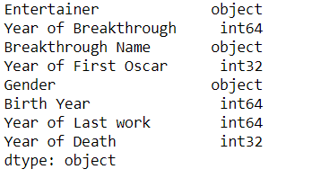
Data Validation and Data Transformation
1. Created age column from year from birth and year of death
Number of variables:
Numeric: 6
Categorical:3
Data types of the columns:

Slide 7
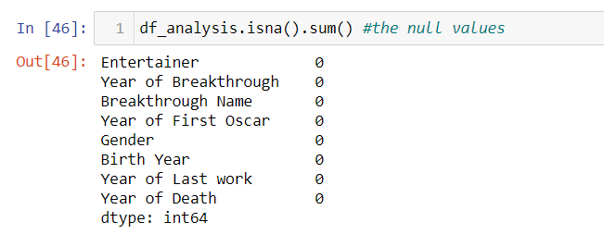
Data Validation

Slide 8
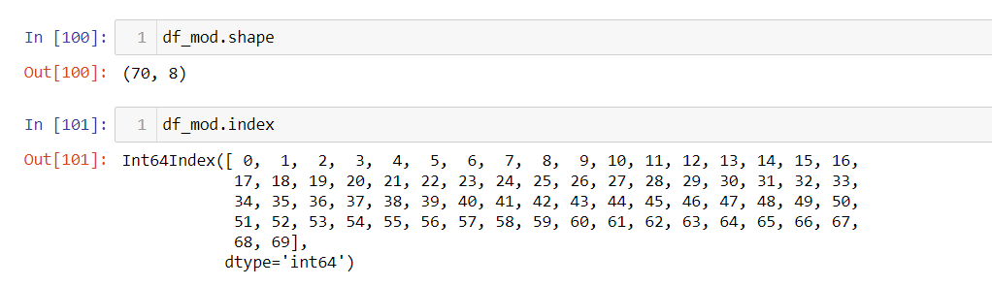
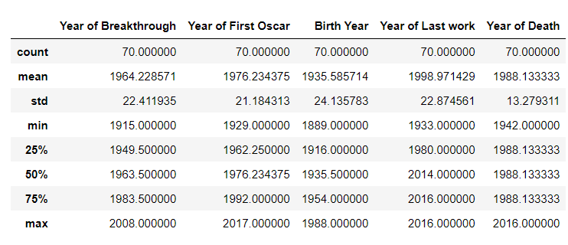
Understanding Data
The shape of the dataset is,
Description of the dataset

Slide 9
Exploratory data analysis
By using Pandas for deriving insights from the data , following insights are :
1. Unique Breakthrough names
2. Unique Entertainers
3. Unique death , birth years , Oscar year , breakthrough year, last work years
4. Entertainers with max year of last work
5. Entertainers with genders
6. Entertainers with birth years

Slide 10
Reports and visualizations
Following visuals are added to the reports and dashboards:
Extracting Entertainers name , breakthrough names by:
1. Age by Birth Year and Gender
2. Age by Death Year and Gender
3. Age by Oscar year and gender with breakthrough names
4. Age by last work year and gender with breakthrough names

Slide 11
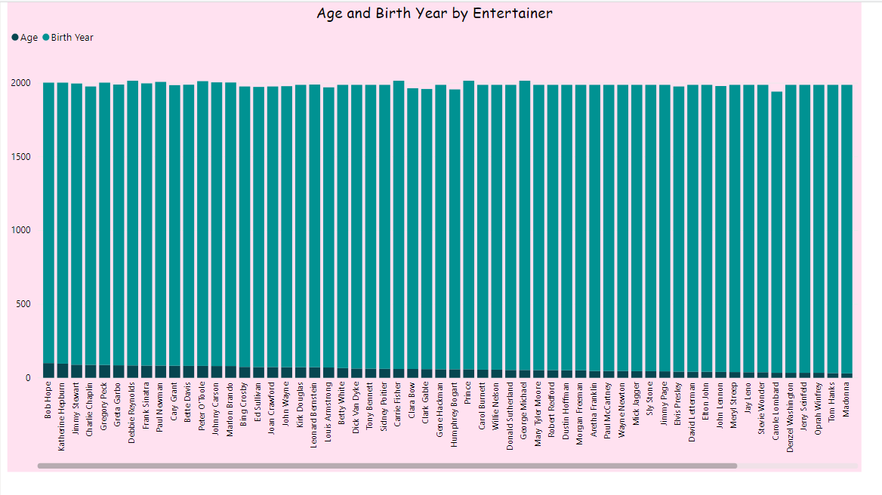
Visualizations
The Visualization displays about the entertainers with the max age and birth year
Insights from the visual:
Max age from male Bob Hope(100) and jimmy stewart (89).
Max age form female is katherina hepborn(96)

Slide 12
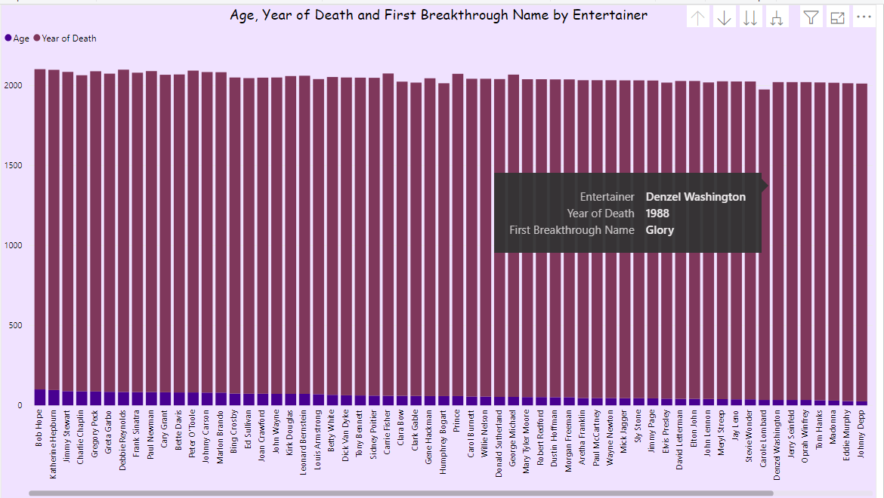
The Visualization displays about the entertainers with their death year and breakthrough names.
Insights from the visual:
-People who died very early less than 22 years of age :
Will smith
Jennifer Aniston
Mariea Carey
Lonardo DiCarpey
Argilena jolie
Justin Temberlake
Lady Gaga

Slide 13
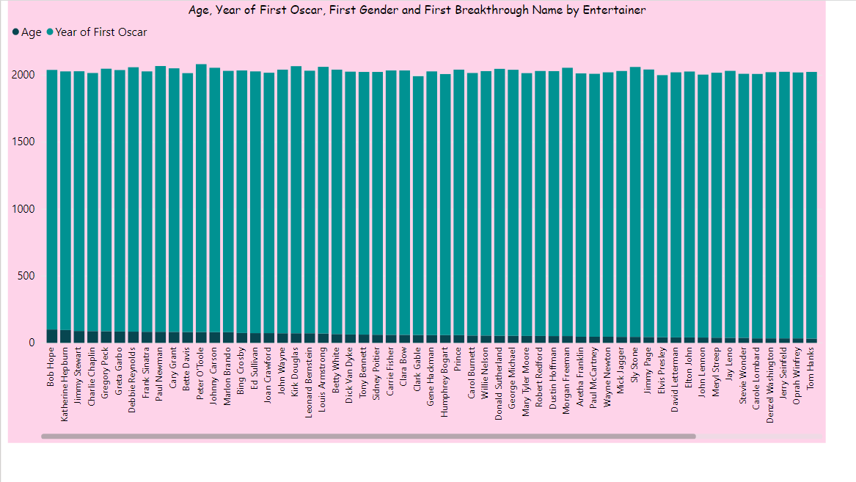
The visualization displays about entertainers and breakthrough names with gender , Oscar year Insights from the visual:
People who got Oscar at less than 20 yrs of age
Will smith
Jennifer Aniston
Mariea Carey
Lonardo DiCarpey
Argilena jolie
Justin Temberlake
Lady Gaga
- Bob Hope got the Oscar at the age of 100 for the big broadcast of 1938.

Slide 14
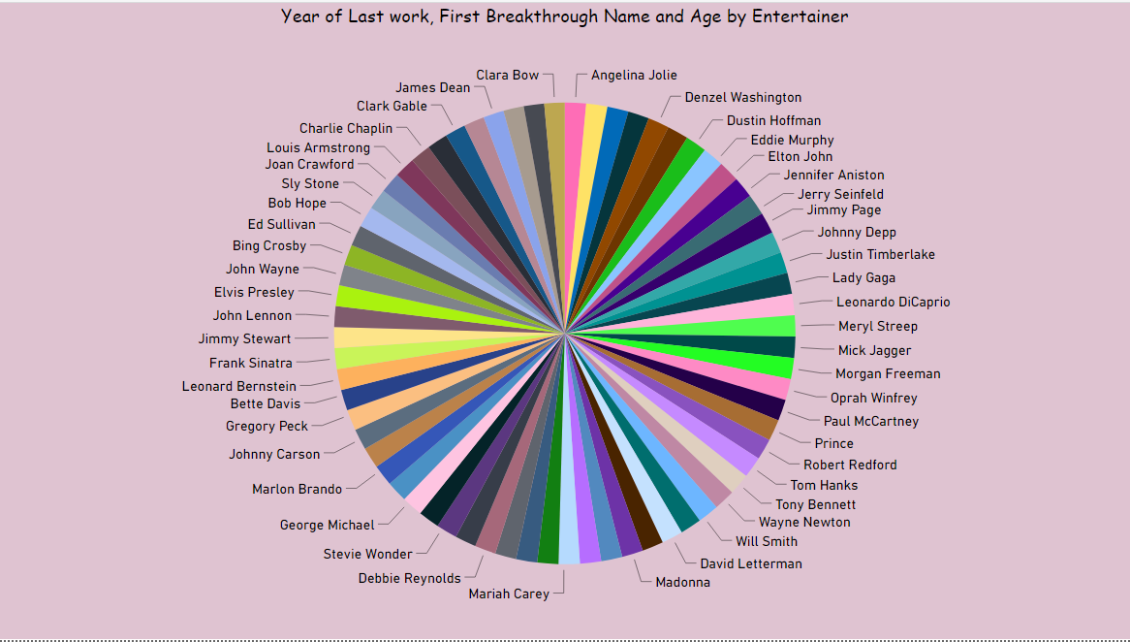
The visualization displays about the entertainers , breakthrough names , last work year.
Insights from the visual:
The last year of work done by the people at the age more than 76
Peter O Toole
Debbis Renoylds
Paul Newman
Marlon Brando
Katherine Hepburn
Johnny Carson
Gregory Peck
Bette Davis
Frank Sinatra
Jimmy Stewart
Bob Hope
Charlie Chaplin
Cary Grant
Greta Garbo

Slide 15
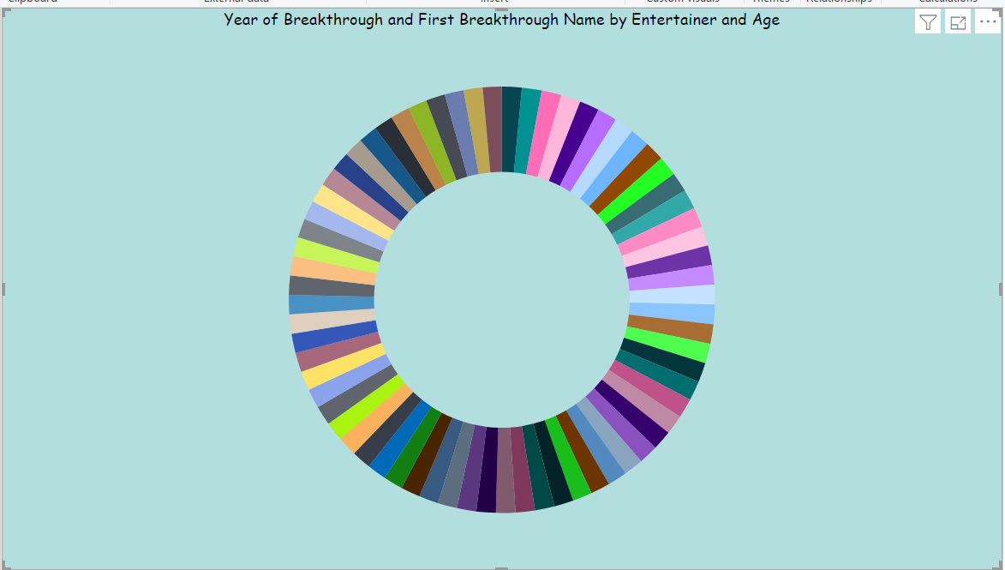
- The visual displays about the entertainers Breakthrough names and ages
Insights from the visual
More people achieved breakthrough at the age of 34
Denzil Washngton
Carole lamboard
Oprah Winfrey
Jerry Sienfield

Slide 16
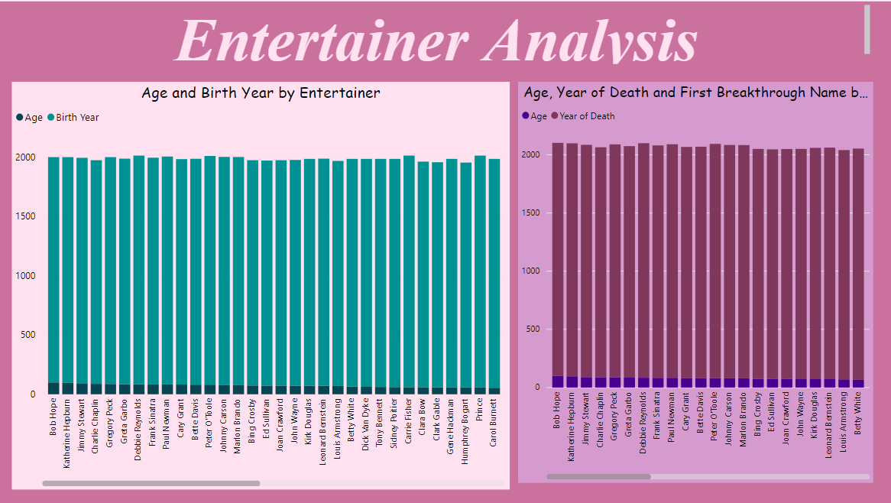
Dashboard
The dashboard displays about the entertainers birth year , death year and other measures
Insights from the dashboard
Charlie Chaplin born at 1889 and died at 1977
Bob Hope born at 1903 and died at 2003.
Angilena jolie born at 1975 and died at the age 1988 who died very early.

Slide 17
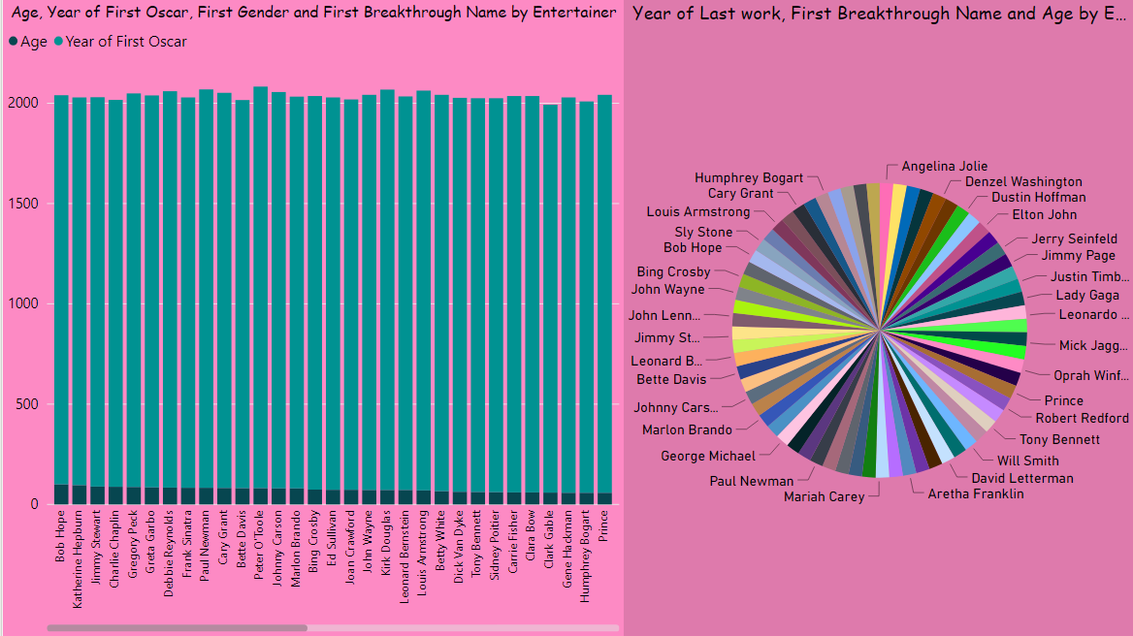
The dashboard displays about the entertainers last work year , year of Oscar with age .
Insights from the dashboard:
Angilena Jolie got Oscar at 1999 and last work done was 2016
Bob hope last work done was at 1972
Charlie Chaplin last work done was at year 1967.

Slide 18
Q and A
Q1. What is the source of the data?
https://drive.google.com/drive/folders/1sJm4vy-qfuk3CFgE_zMMPGVYFmoIg35n?usp=sharing
Q2. What is the type of data variables?
Categorical and numerical
Q3. What techniques are used to perform data preparation?
Removing columns
Deriving column
Filtering the values
Checking for null values

Slide 19
Q4. What libraries are used to perform data visualization?
Seaborn
- Plotly Express

